Slide 1
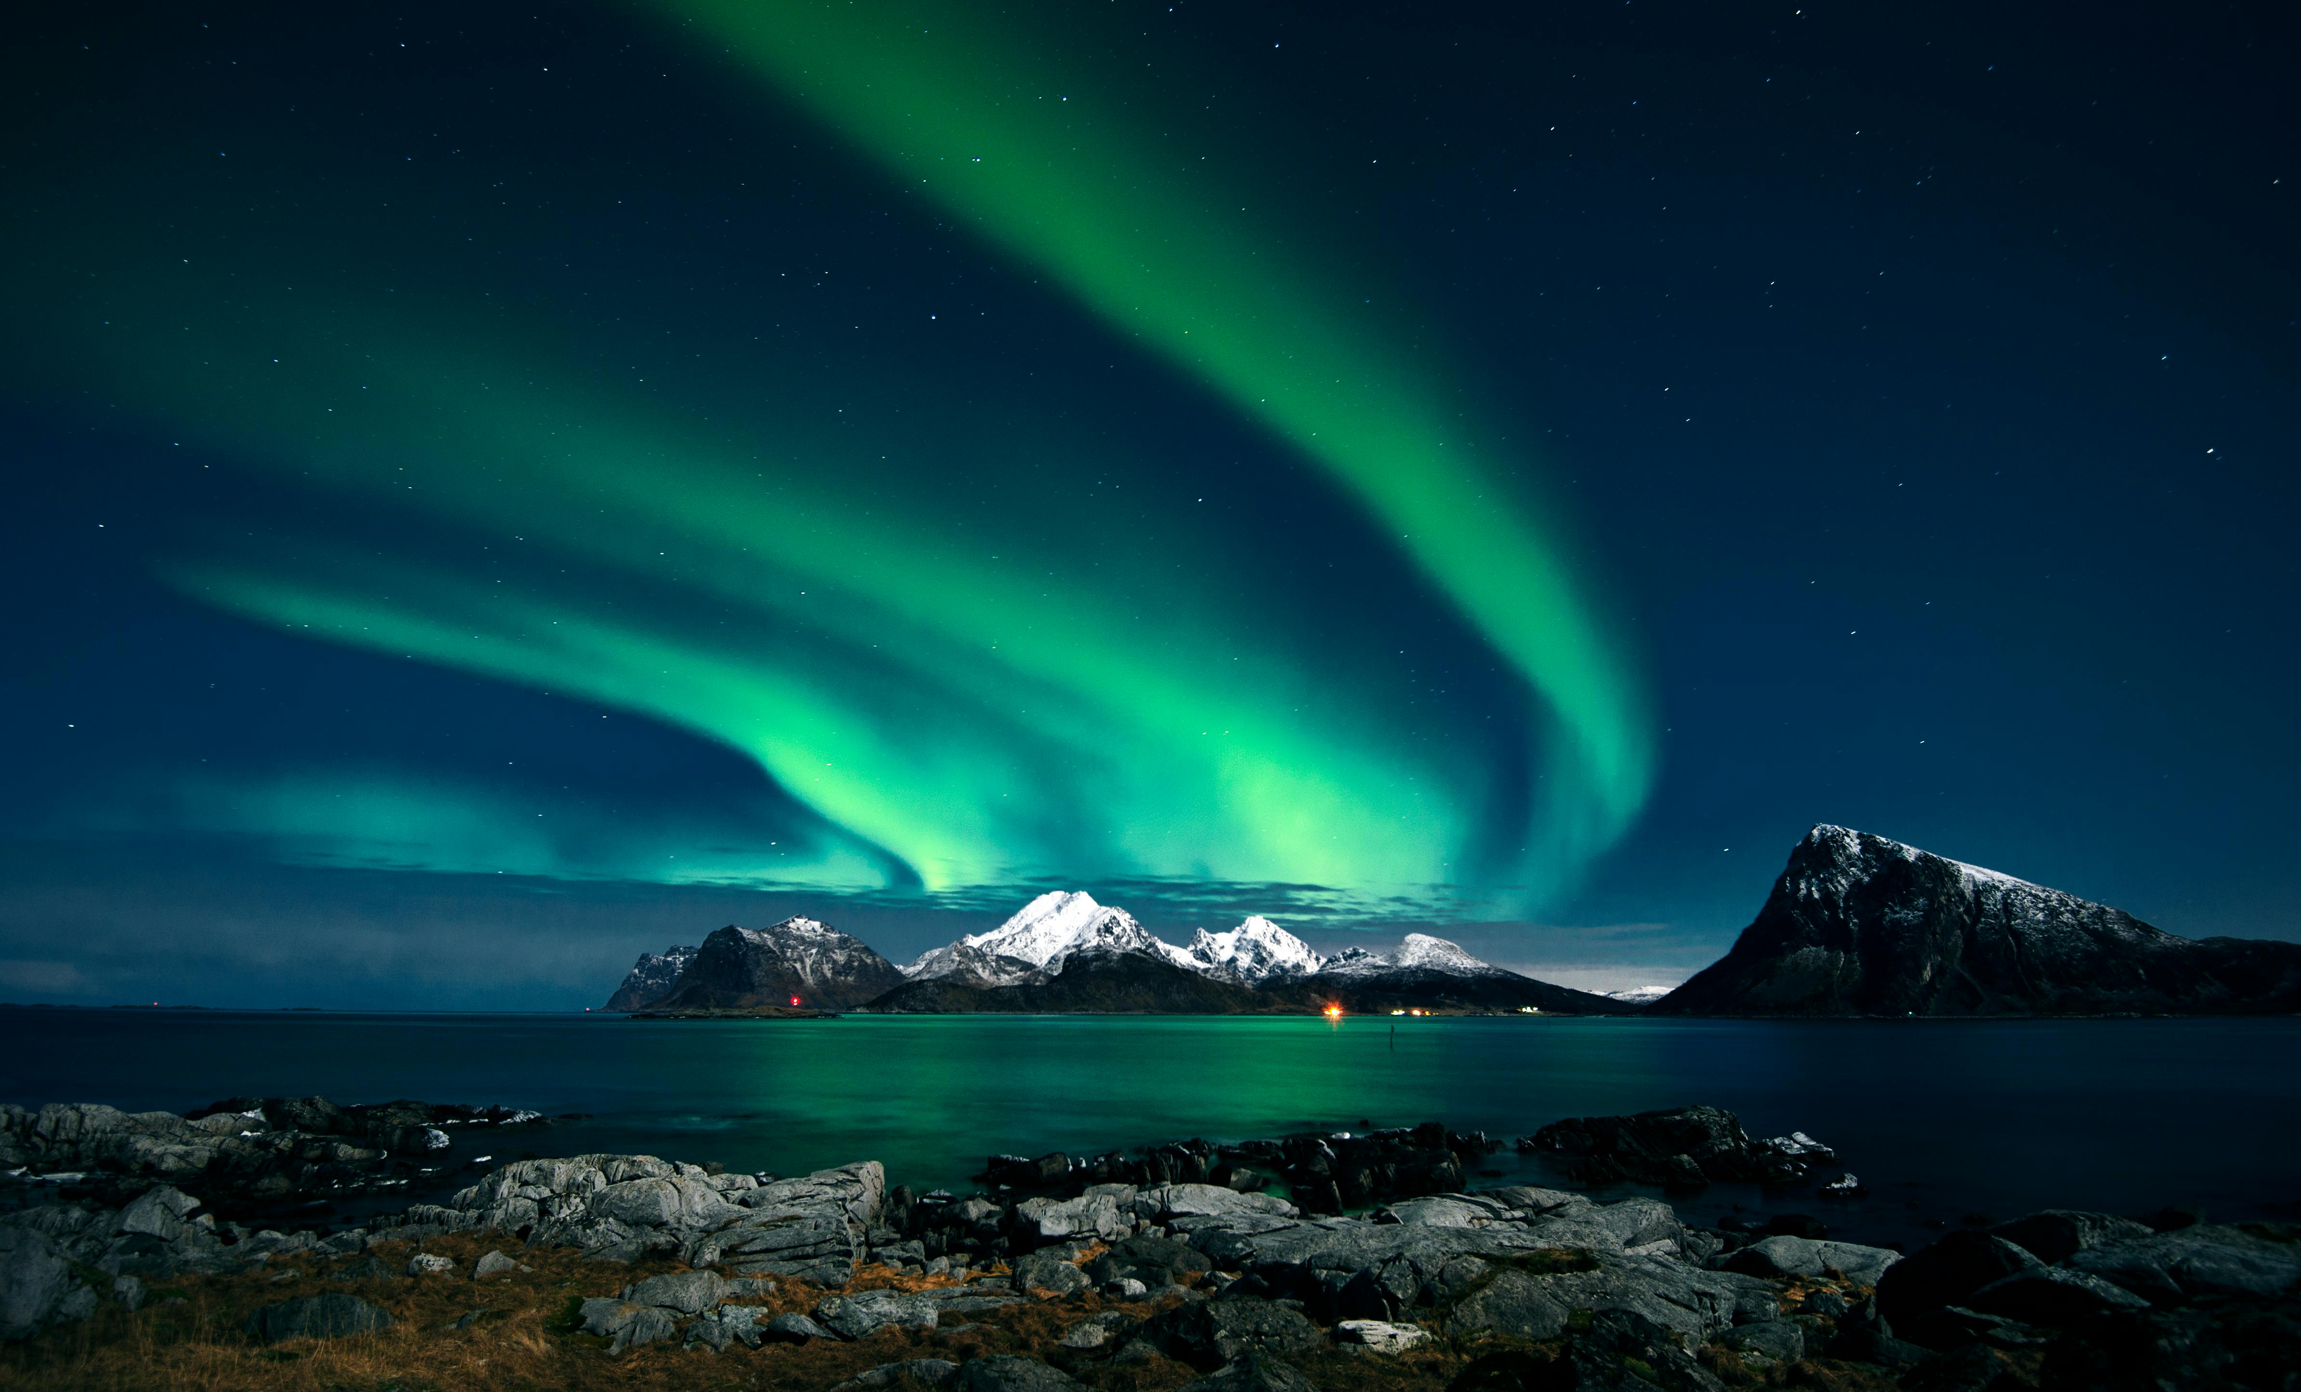
SLIDE 4
Title 1: Green Northern Lights The green northern lights, also known as the aurora borealis, light up the night sky in magical waves. These lights are created when charged particles from the sun collide with Earth’s atmosphere, creating vivid green displays that shimmer and dance across the darkness. Seeing them feels like watching the sky come alive with nature’s own artistry.
Title 2: Blue Sea The blue sea stretches endlessly, its color shifting with the sky above and the depth below. Calm and gentle at times, fierce and roaring at others, the sea holds mysteries and stories from every corner of the world. Its blue hue soothes the soul and invites adventurers to explore its vast beauty.
Title 3: Waterfall A waterfall is nature’s raw, rushing music — water plunging from great heights, breaking into mist and roaring into rivers below. Some waterfalls are mighty and thunderous, while others are soft and graceful. Each one is a reminder of the unstoppable energy and beauty that flows through our planet.
Title 4: Red Flower Red flowers, like roses and poppies, symbolize love, strength, and beauty. Their bold, rich color stands out against green fields and gardens, catching the eye instantly. Each red petal is like a soft flame, full of life and emotion, making these flowers timeless symbols across cultures.
SLIDE 3
SLIDE 1
SLIDE 2

Slide 2
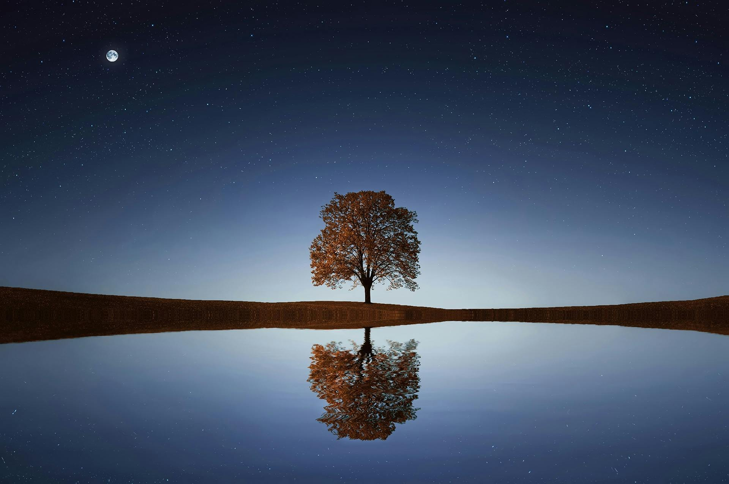
Title 1: Green Northern Lights The green northern lights, also known as the aurora borealis, light up the night sky in magical waves. These lights are created when charged particles from the sun collide with Earth’s atmosphere, creating vivid green displays that shimmer and dance across the darkness. Seeing them feels like watching the sky come alive with nature’s own artistry.
Title 2: Blue Sea The blue sea stretches endlessly, its color shifting with the sky above and the depth below. Calm and gentle at times, fierce and roaring at others, the sea holds mysteries and stories from every corner of the world. Its blue hue soothes the soul and invites adventurers to explore its vast beauty.
Title 3: Waterfall A waterfall is nature’s raw, rushing music — water plunging from great heights, breaking into mist and roaring into rivers below. Some waterfalls are mighty and thunderous, while others are soft and graceful. Each one is a reminder of the unstoppable energy and beauty that flows through our planet.
Title 4: Red Flower Red flowers, like roses and poppies, symbolize love, strength, and beauty. Their bold, rich color stands out against green fields and gardens, catching the eye instantly. Each red petal is like a soft flame, full of life and emotion, making these flowers timeless symbols across cultures.
SLIDE 4
SLIDE 3
SLIDE 1
SLIDE 2

Slide 3
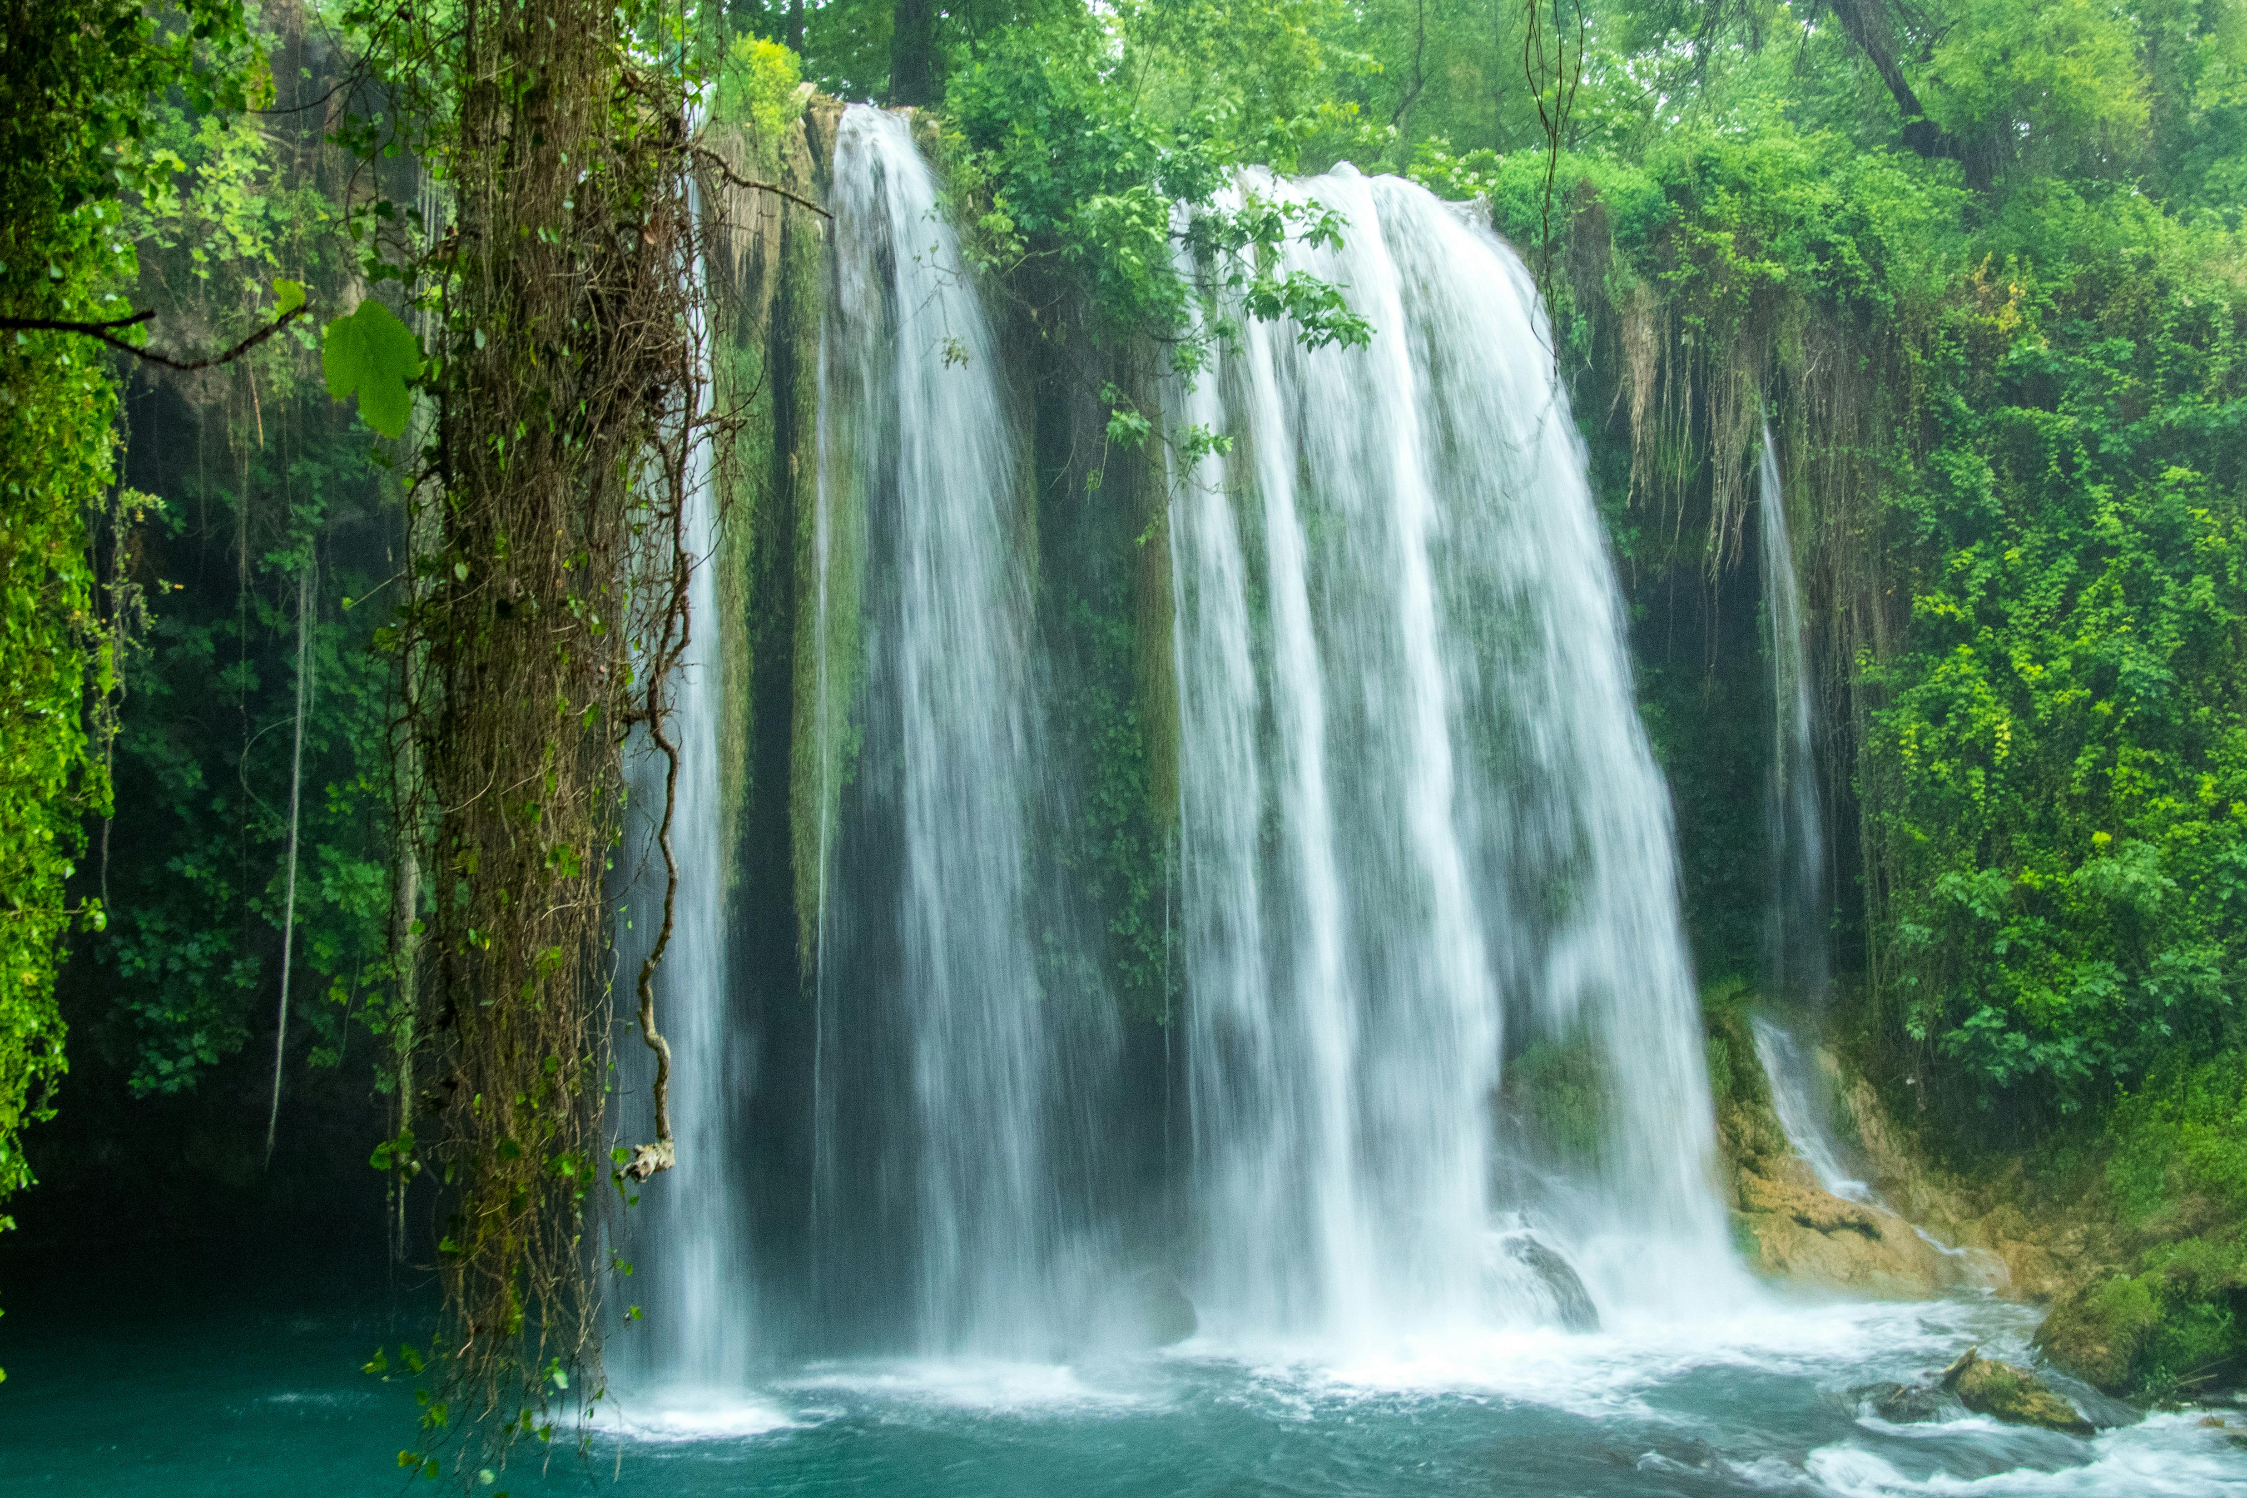
Title 1: Green Northern Lights The green northern lights, also known as the aurora borealis, light up the night sky in magical waves. These lights are created when charged particles from the sun collide with Earth’s atmosphere, creating vivid green displays that shimmer and dance across the darkness. Seeing them feels like watching the sky come alive with nature’s own artistry.
Title 2: Blue Sea The blue sea stretches endlessly, its color shifting with the sky above and the depth below. Calm and gentle at times, fierce and roaring at others, the sea holds mysteries and stories from every corner of the world. Its blue hue soothes the soul and invites adventurers to explore its vast beauty.
Title 3: Waterfall A waterfall is nature’s raw, rushing music — water plunging from great heights, breaking into mist and roaring into rivers below. Some waterfalls are mighty and thunderous, while others are soft and graceful. Each one is a reminder of the unstoppable energy and beauty that flows through our planet.
Title 4: Red Flower Red flowers, like roses and poppies, symbolize love, strength, and beauty. Their bold, rich color stands out against green fields and gardens, catching the eye instantly. Each red petal is like a soft flame, full of life and emotion, making these flowers timeless symbols across cultures.
SLIDE 4
SLIDE 3
SLIDE 1
SLIDE 2

Slide 4
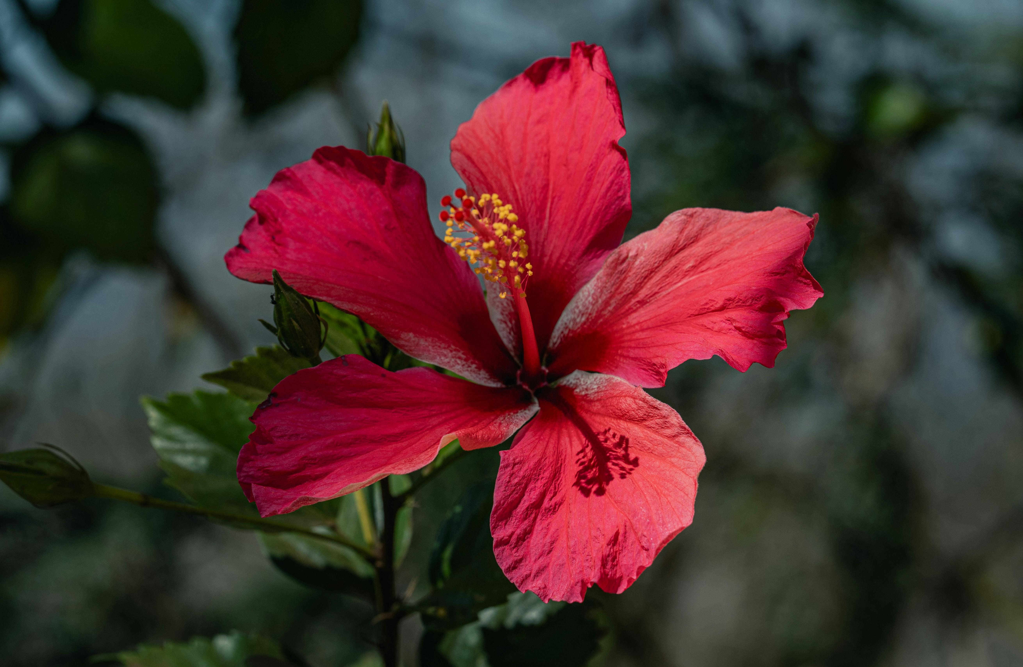
Title 1: Green Northern Lights The green northern lights, also known as the aurora borealis, light up the night sky in magical waves. These lights are created when charged particles from the sun collide with Earth’s atmosphere, creating vivid green displays that shimmer and dance across the darkness. Seeing them feels like watching the sky come alive with nature’s own artistry.
Title 2: Blue Sea The blue sea stretches endlessly, its color shifting with the sky above and the depth below. Calm and gentle at times, fierce and roaring at others, the sea holds mysteries and stories from every corner of the world. Its blue hue soothes the soul and invites adventurers to explore its vast beauty.
Title 3: Waterfall A waterfall is nature’s raw, rushing music — water plunging from great heights, breaking into mist and roaring into rivers below. Some waterfalls are mighty and thunderous, while others are soft and graceful. Each one is a reminder of the unstoppable energy and beauty that flows through our planet.
Title 4: Red Flower Red flowers, like roses and poppies, symbolize love, strength, and beauty. Their bold, rich color stands out against green fields and gardens, catching the eye instantly. Each red petal is like a soft flame, full of life and emotion, making these flowers timeless symbols across cultures.
SLIDE 4
SLIDE 3
SLIDE 1
SLIDE 2

